Slide 1

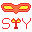
Points and Sprites in Three.js
By : Group 5

Slide 2
What is Points and Sprites?
01
How do you use it?
02
TABLE OF CONTENTS
When do you use it?
03
Why is it important?
04
Codes Example
05

Slide 3
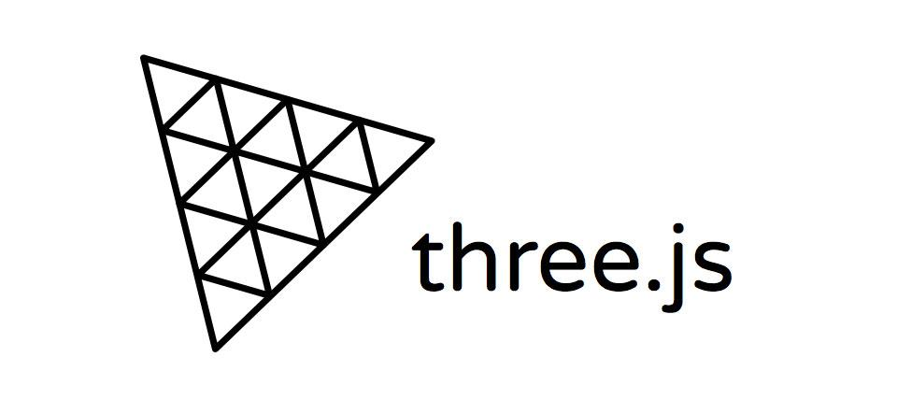
What is Three.js?
Three.js is a cross-browser JavaScript library and application programming interface used to create and display animated 3D computer graphics in a web browser using WebGL.

Slide 4
In short,
It is a Javascript library to make games and 3D application. It uses WebGL, JavaScript's API to render 2D and 3D without additional browser plugin

Slide 5
What is Points and Sprites?
01

Slide 6
Points

Slide 7
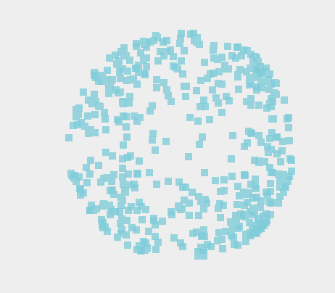
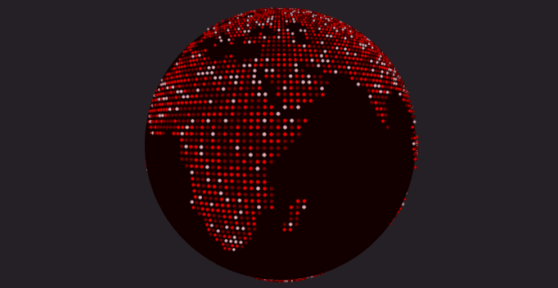
Definition
Points is a class for displaying points. The points are rendered by the WebGLRenderer using gl.POINTS.

Slide 8
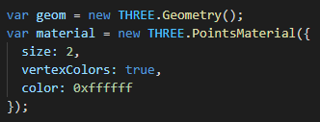
Constructor
Points( geometry : BufferGeometry, material : Material )
geometry — (optional) an instance of BufferGeometry. Default is a new BufferGeometry.
material — (optional) a Material. Default is a new PointsMaterial.

Slide 9
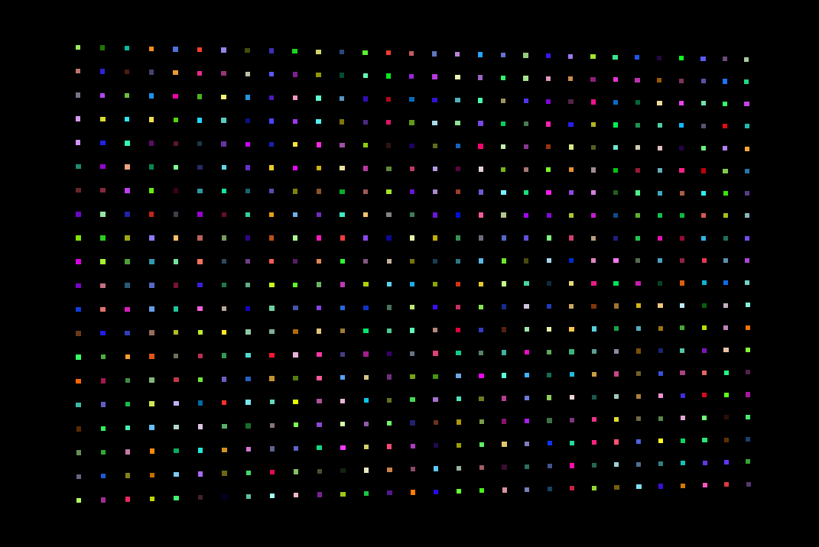
Properties
.geometry : BufferGeometry
An instance of BufferGeometry (or derived classes), defining the object's structure.
.material : Material
An instance of Material, defining the object's appearance. Default is a PointsMaterial.

Slide 10
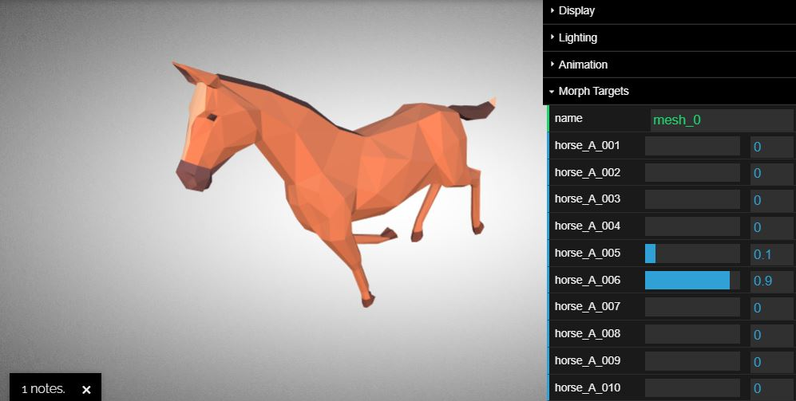
Properties
.morphTargetInfluences : Array
An array of weights typically from 0-1 that specifies how much of the morph is applied. Undefined by default, but reset to a blank array by updateMorphTargets.
.morphTargetDictionary : Object
A dictionary of morphTargets based on the morphTarget.name property. Undefined by default, but rebuilt updateMorphTargets.

Slide 11
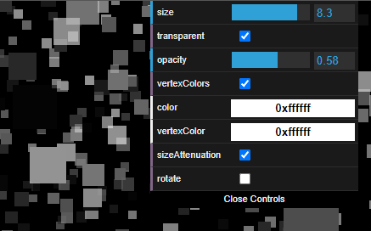
Properties
color
This is the color of all the particles in ParticleSystem .Setting the vertexColors property to true and specifying the colors using the color property of the geometry overrides this property (to be more precise, the color of a vertex will be multiplied with this value to determine the final color). The default value is 0xFFFFFF.

Slide 12
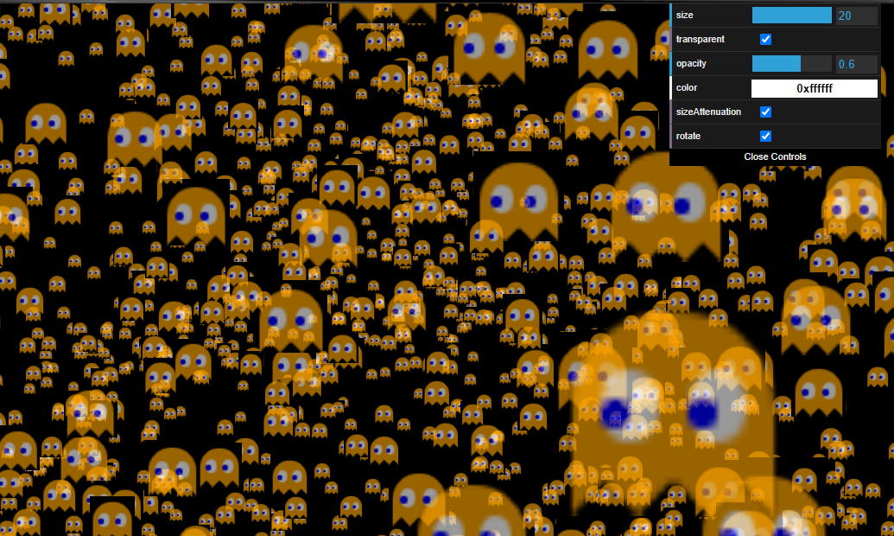
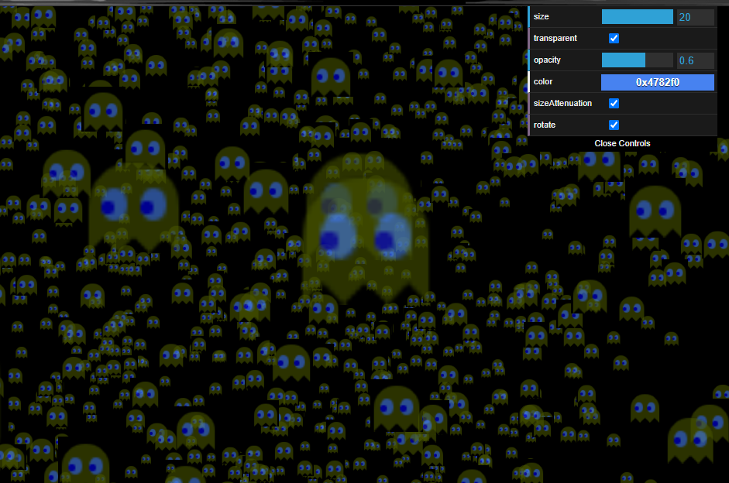
Color Default
Color 0x4782f0

Slide 13
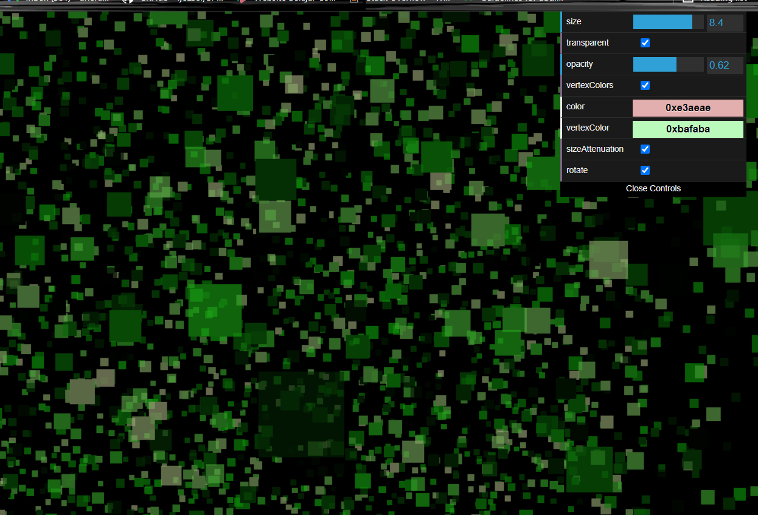
Properties
vertexColors
Normally, all the particles in THREE.PointCloud have the same color. If this property is set to THREE. VertexColors and the colors array in the geometry has been filled, the colors from that array will be used instead (also see the color entry in this table). The default value is THREE.NoColors.

Slide 14
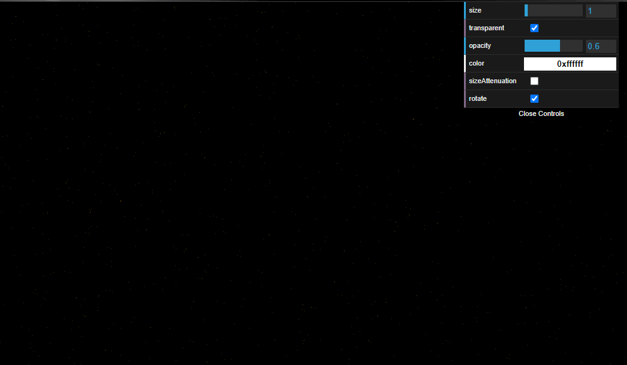
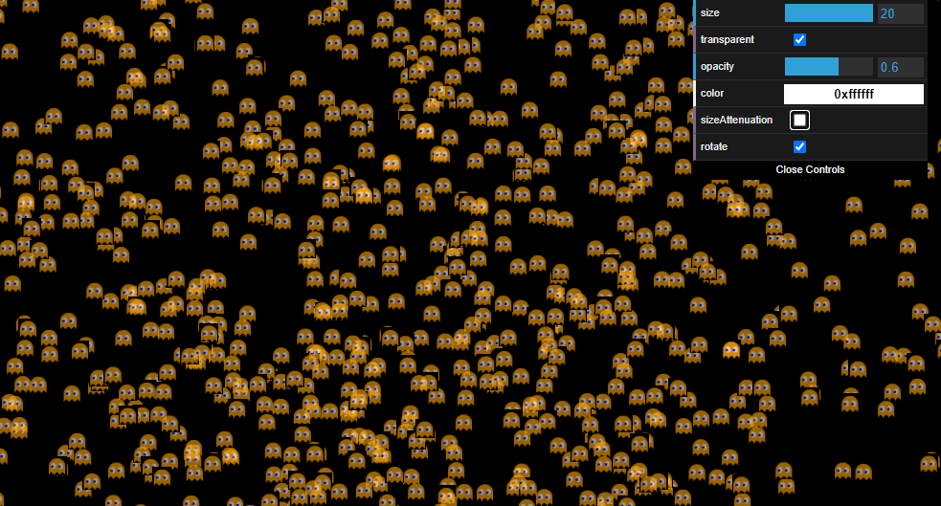
Properties
size
This is the size of the particle. The default value is 1.
sizeAttenuation
If this is set to false, all the particles will have the same size regardless of how far from the camera they are positioned. If this is set to true, the size is based on the distance from the camera. The default value is true.

Slide 15
Size = 20, size Attenuation = false
Size = 1, sizeAttenuation = false

Slide 16
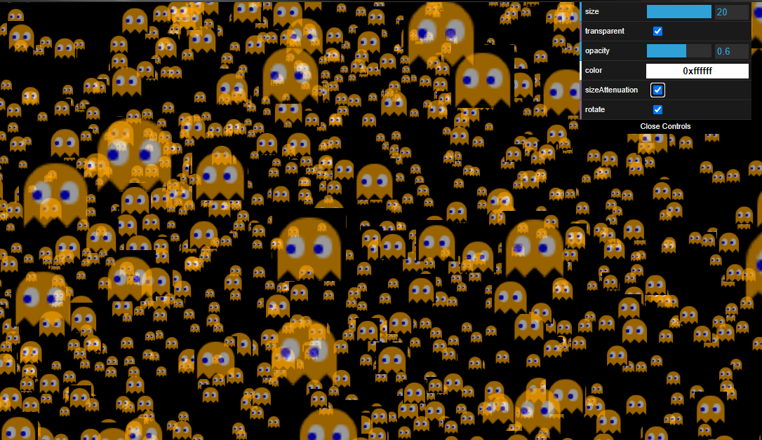
Size = 20, sizeAttenuation = true

Slide 17
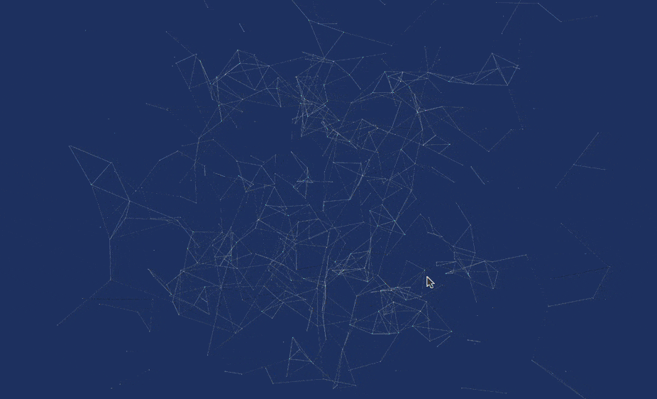
Properties
opacity
This, together with the transparent property, sets the opacity of the particle. The default value is 1 (no opacity).
transparent
If this is set to true, the particle will be rendered with the opacity set by the opacity property. The default value is false.

Slide 18
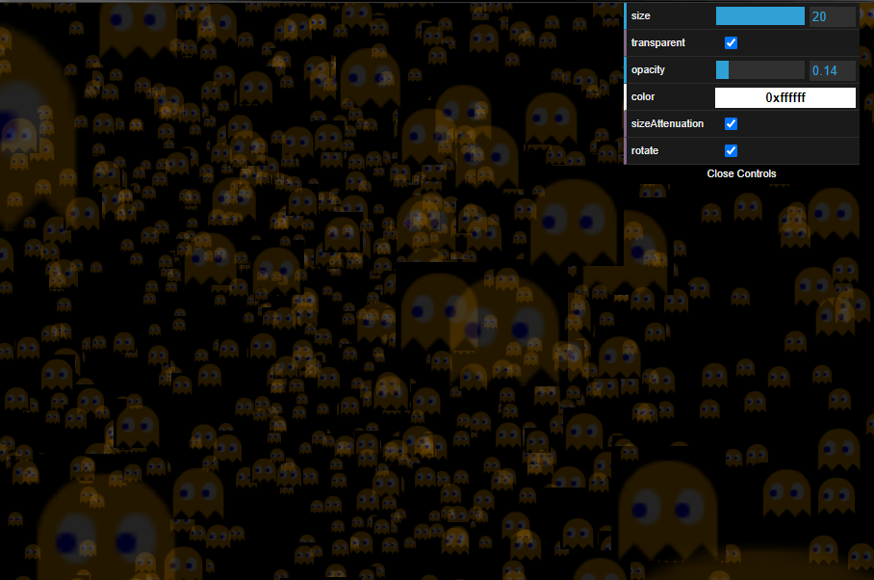
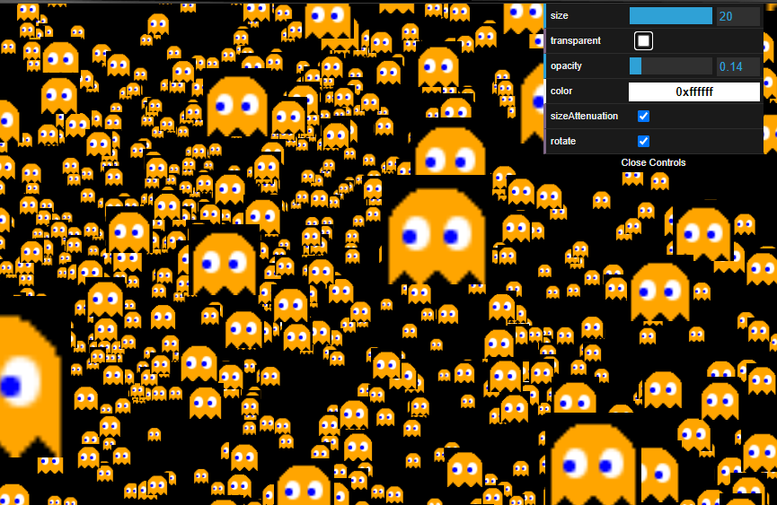
Opacity = 0.14, transparent = false
opacity= 0.14, transparent = true

Slide 19
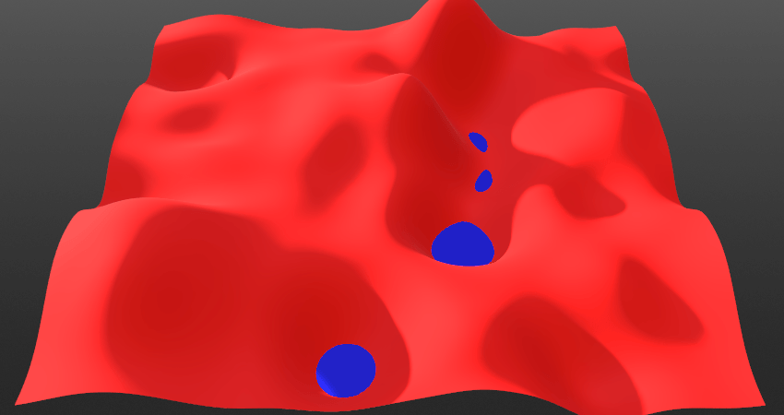
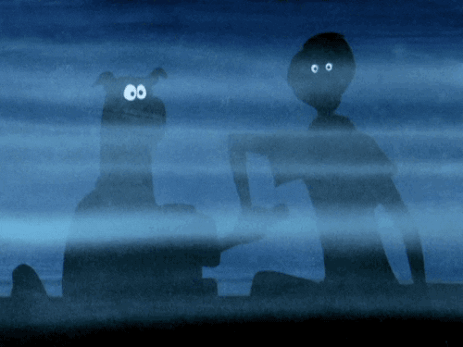
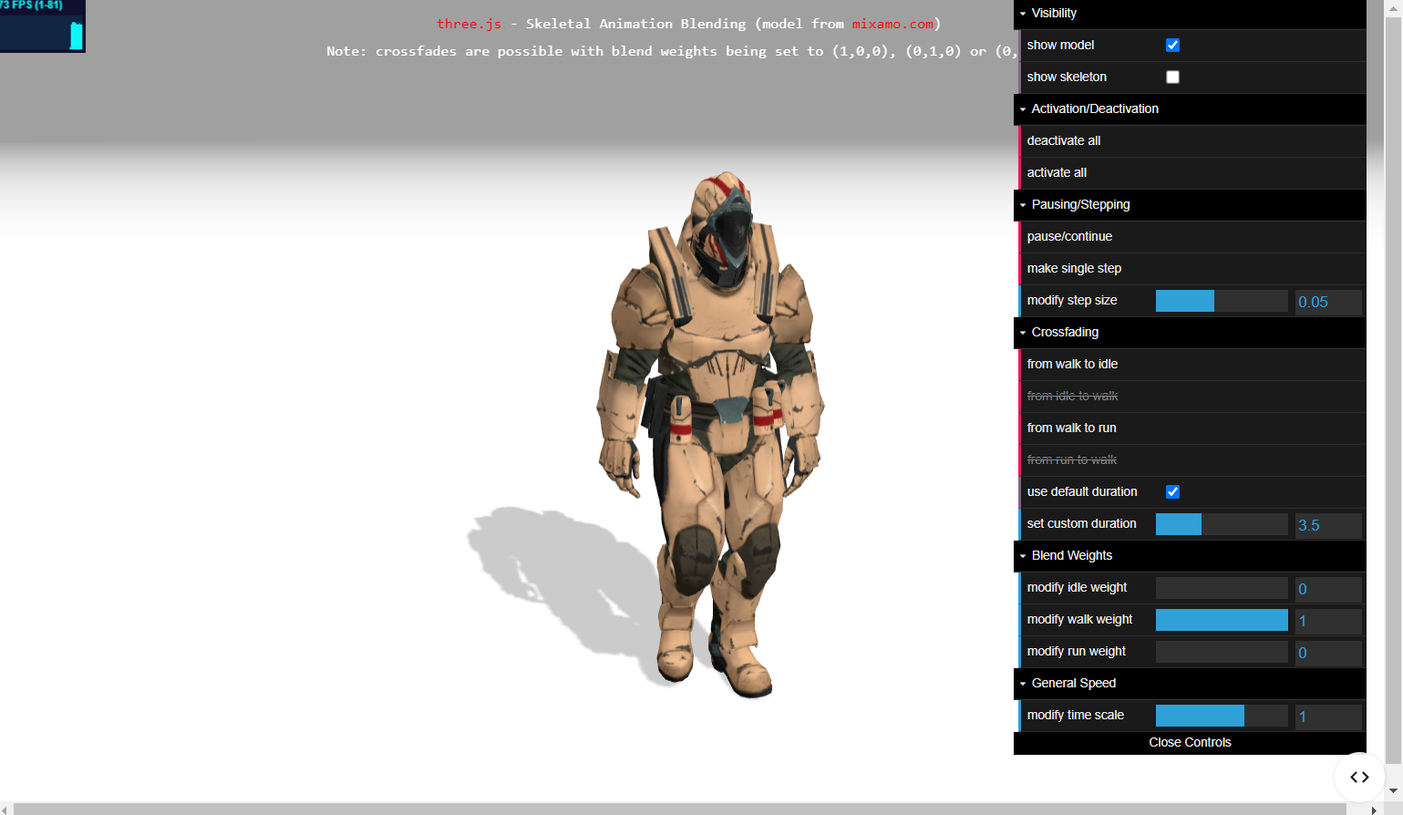
Properties
blending
This is the blend mode to use when rendering the particle.
fog
This determines whether the particles are affected by fog added to the scene. This defaults to true.

Slide 20
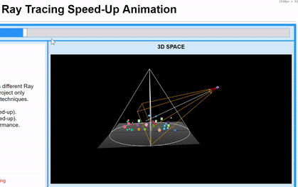
Methods
.raycast ( raycaster : Raycaster, intersects : Array ) : null
Get intersections between a casted ray and this Points. Raycaster.intersectObject will call this method.
.clone () : Points
Returns a clone of this Points object and its descendants.

Slide 21
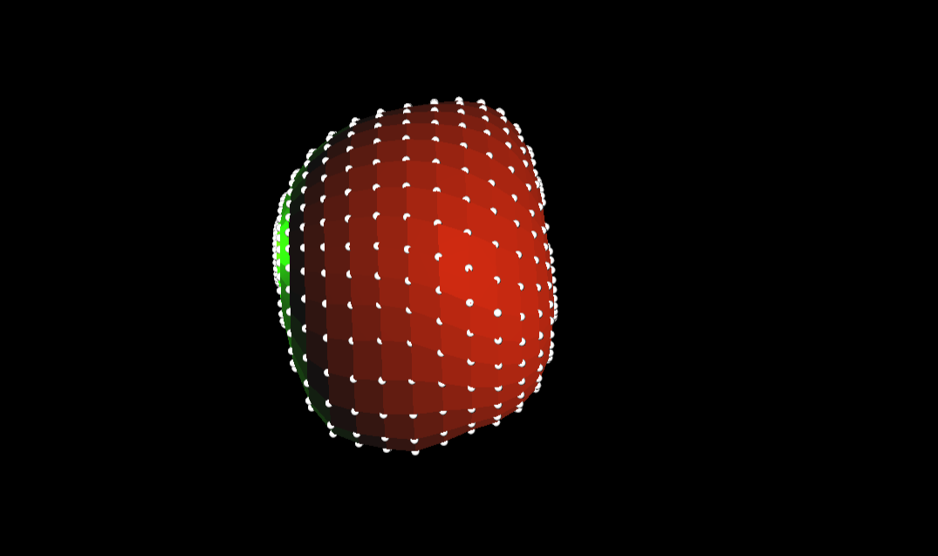
Methods
.updateMorphTargets () : null
Updates the morphTargets to have no influence on the object. Resets the morphTargetInfluences and morphTargetDictionary properties.

Slide 22
Sprites

Slide 23
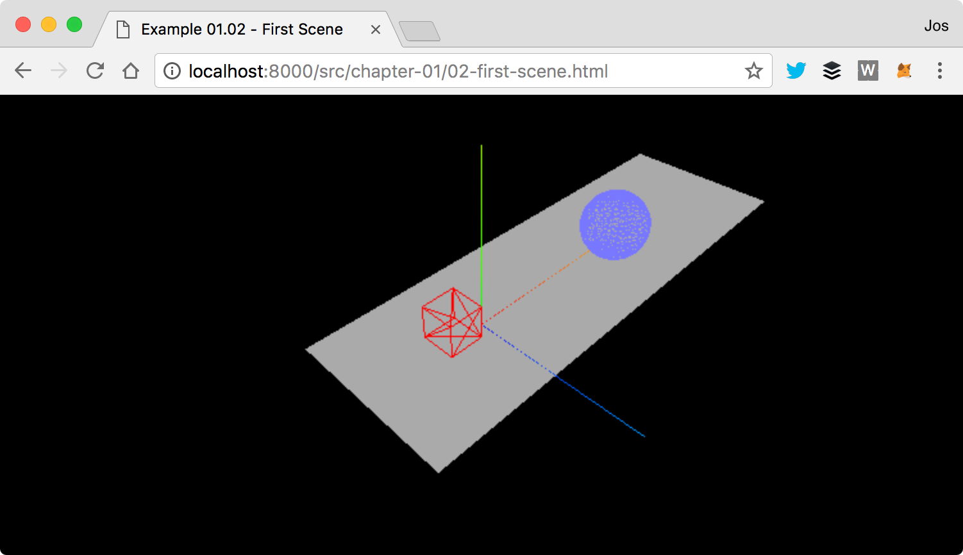
Definition
Plane : This is a two-dimensional rectangle that serves as our ground area. In the screenshot below, this is rendered as the gray rectangle in the middle of the scene.
With THREE.Points (sometimes also called sprites), it is very easy to create many small objects that you can use to simulate rain, snow, smoke, and other interesting effects
A sprite is a 2D plane that always faces the camera. Generally with a partially transparent texture applied.

Slide 24
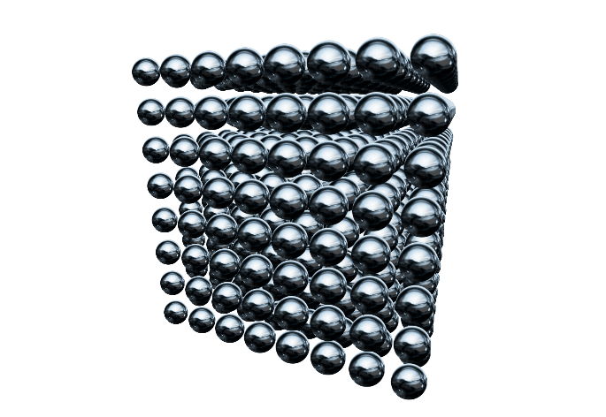
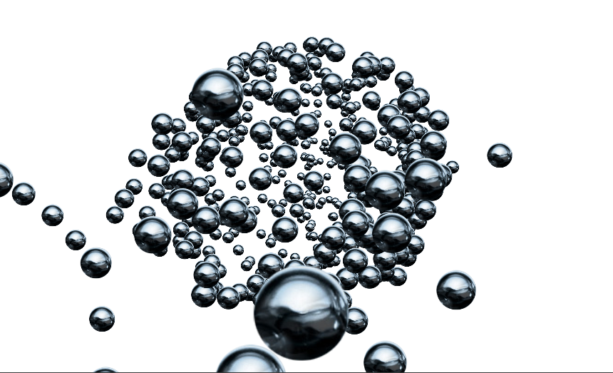
Constructor
Sprite( material : Material )
material - (optional) an instance of SpriteMaterial. Default is a white SpriteMaterial.

Slide 25

Properties
.material : SpriteMaterial
An instance of SpriteMaterial, defining the object's appearance. Default is a white SpriteMaterial.

Slide 26
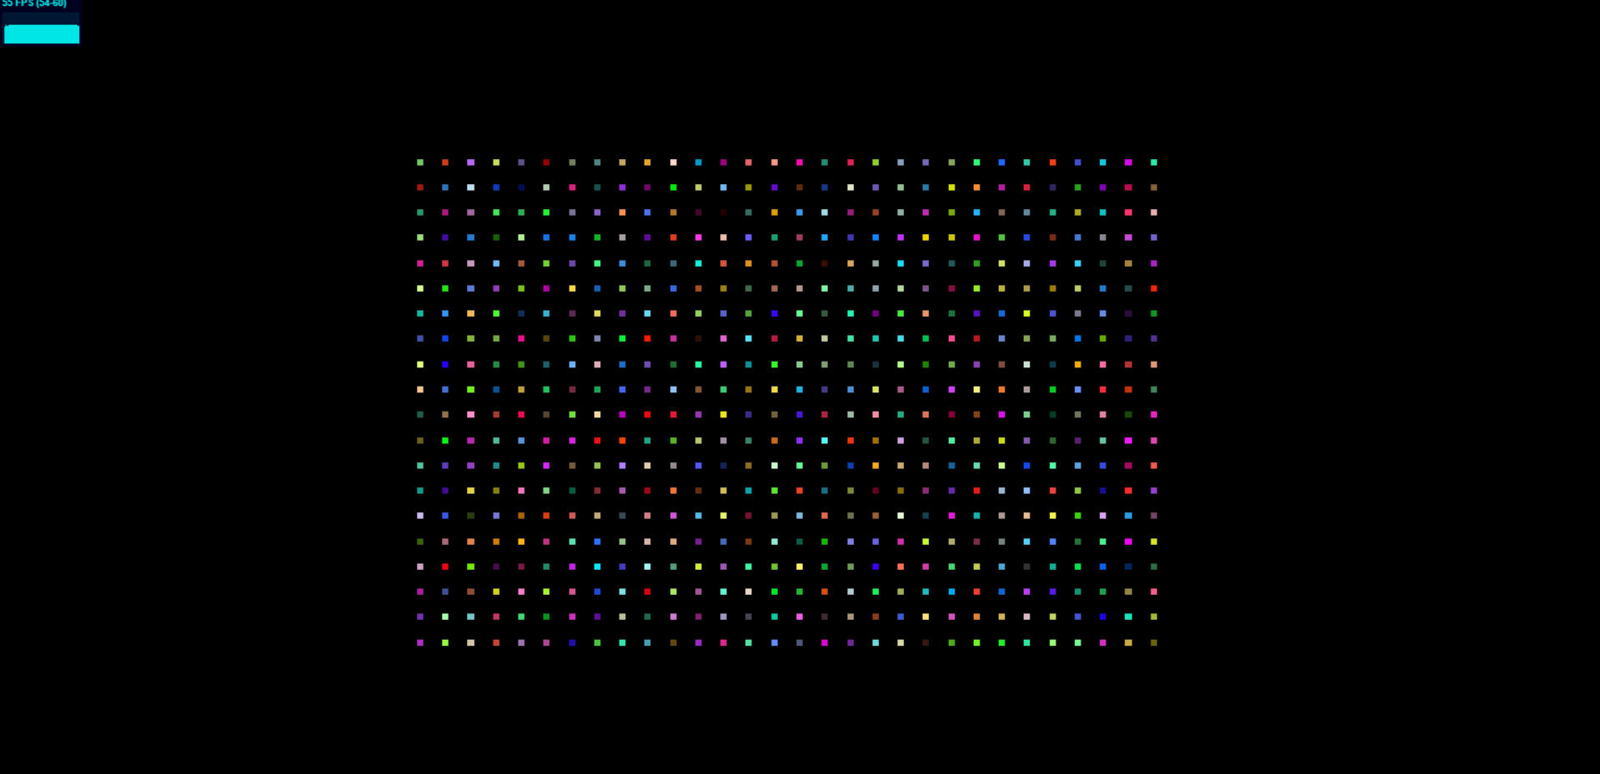
Properties
.center : Vector2
The sprite's anchor point, and the point around which the sprite rotates. A value of (0.5, 0.5) corresponds to the midpoint of the sprite. A value of (0, 0) corresponds to the lower left corner of the sprite. The default is (0.5, 0.5).
Plane : This is a two-dimensional rectangle that serves as our ground area. In the screenshot below, this is rendered as colorful points in the middle of the scene.
Notes:
center objek

Slide 27
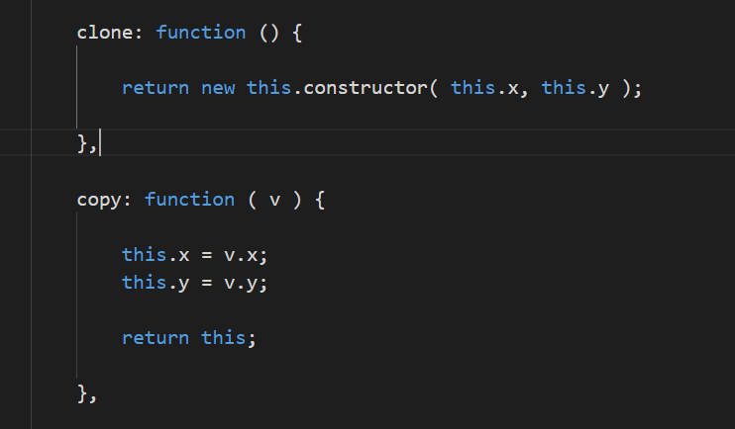
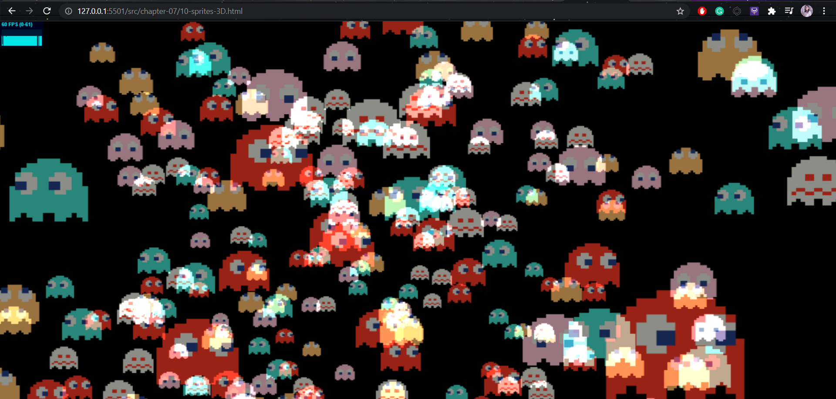
Methods
.clone () : Sprite
Returns a clone of this Sprite object and
any descendants.
.copy ( sprite : Sprite ) : Sprite
Copies the properties of the passed
sprite to this one
Notes:
Misal ada object A dan object B, jika object A.copy() ke B, maka isinya B sama dengan A. Jika object A.clone() maka akan menghasilkan C dengan C == A (spawning)

Slide 28
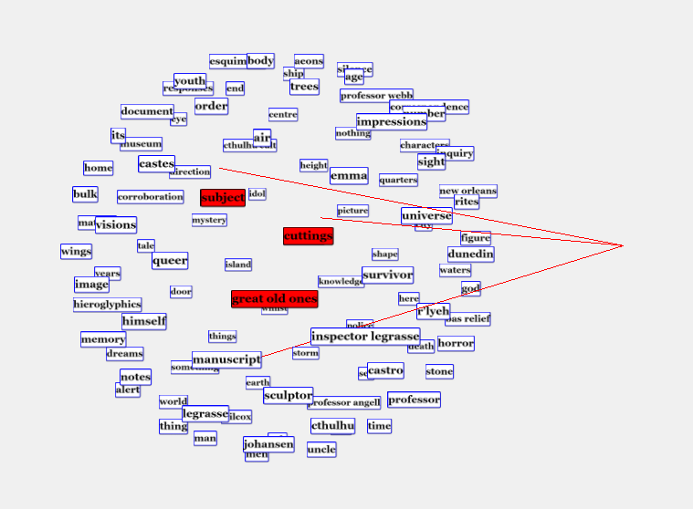
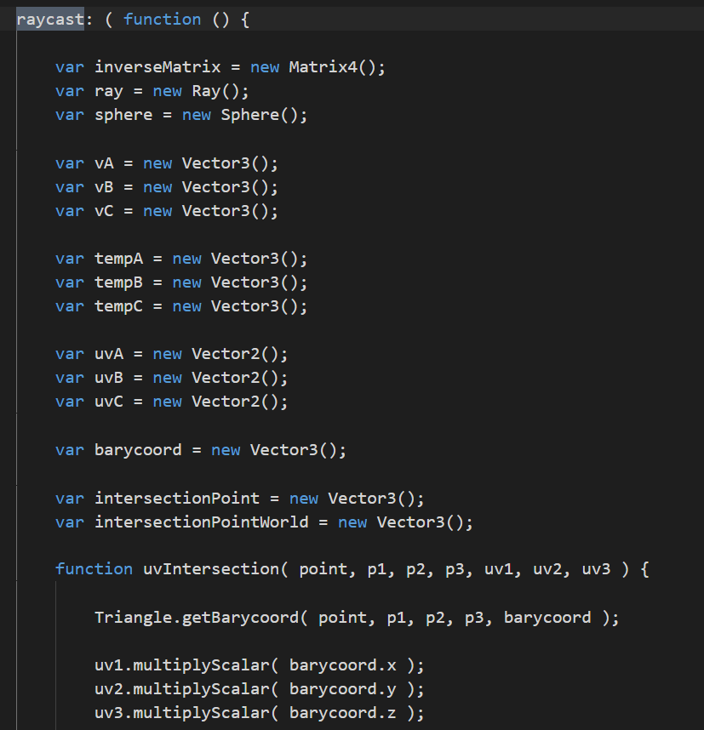
Methods
.raycast ( raycaster : Raycaster, intersects : Array ) : null
Get intersections between a casted ray and this sprite. Raycaster.intersectObject() will call this method. The raycaster must be initialized by calling Raycaster.setFromCamera() before raycasting against sprites.
Notes:
untuk mengecek apakah intersection dengan geometri. semua objek masuk ke dalam raycast tapi yang ditampilkan biasanya hanya yang depan/tampak

Slide 29
How & When do we use it?
02

Slide 30
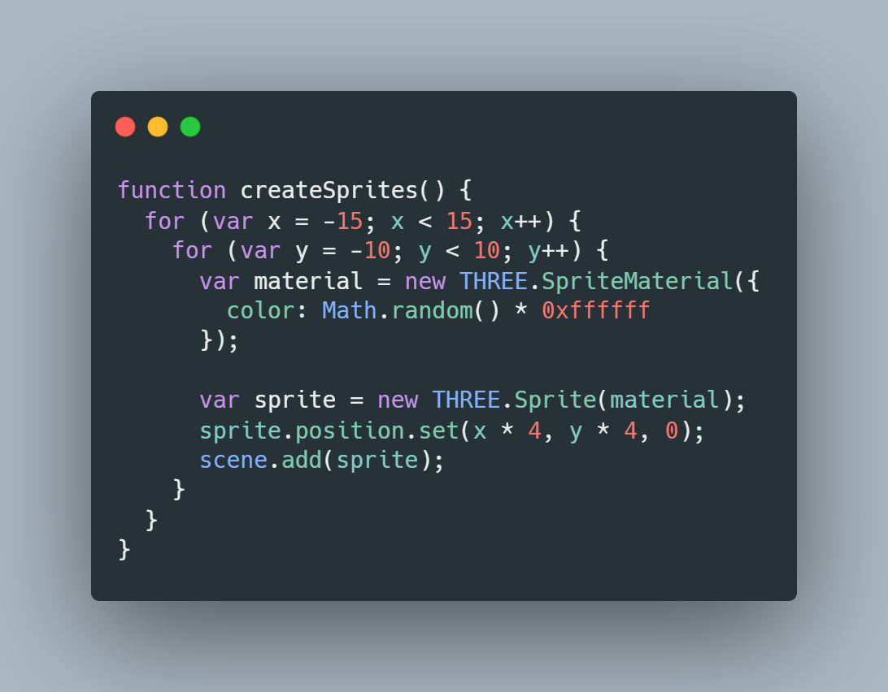
Sprites
In this example, we create the sprites manually using the THREE.Sprite(material) constructor. The only item we pass in is a material. This has to be either THREE.SpriteMaterial or THREE.SpriteCanvasMaterial.
Note :
A THREE.Sprite used to be called a THREE.Particle, and the materials have also undergone a number of name changes. So, if we see these old names in some code, remember that they are talking about the same concepts.

Slide 31
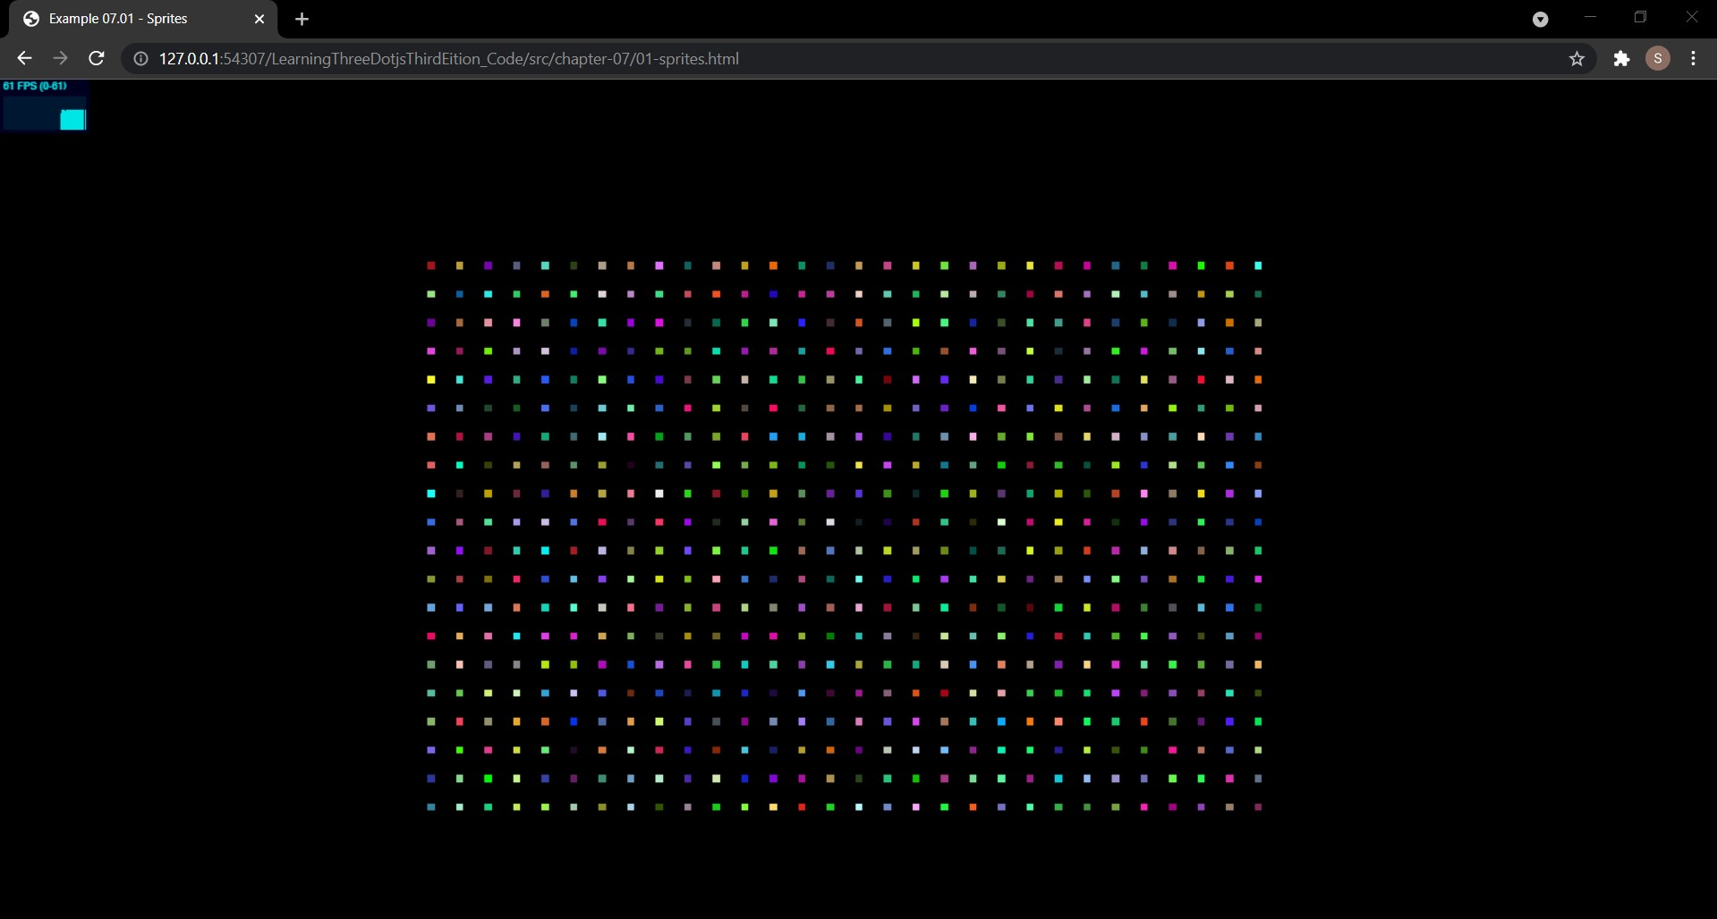
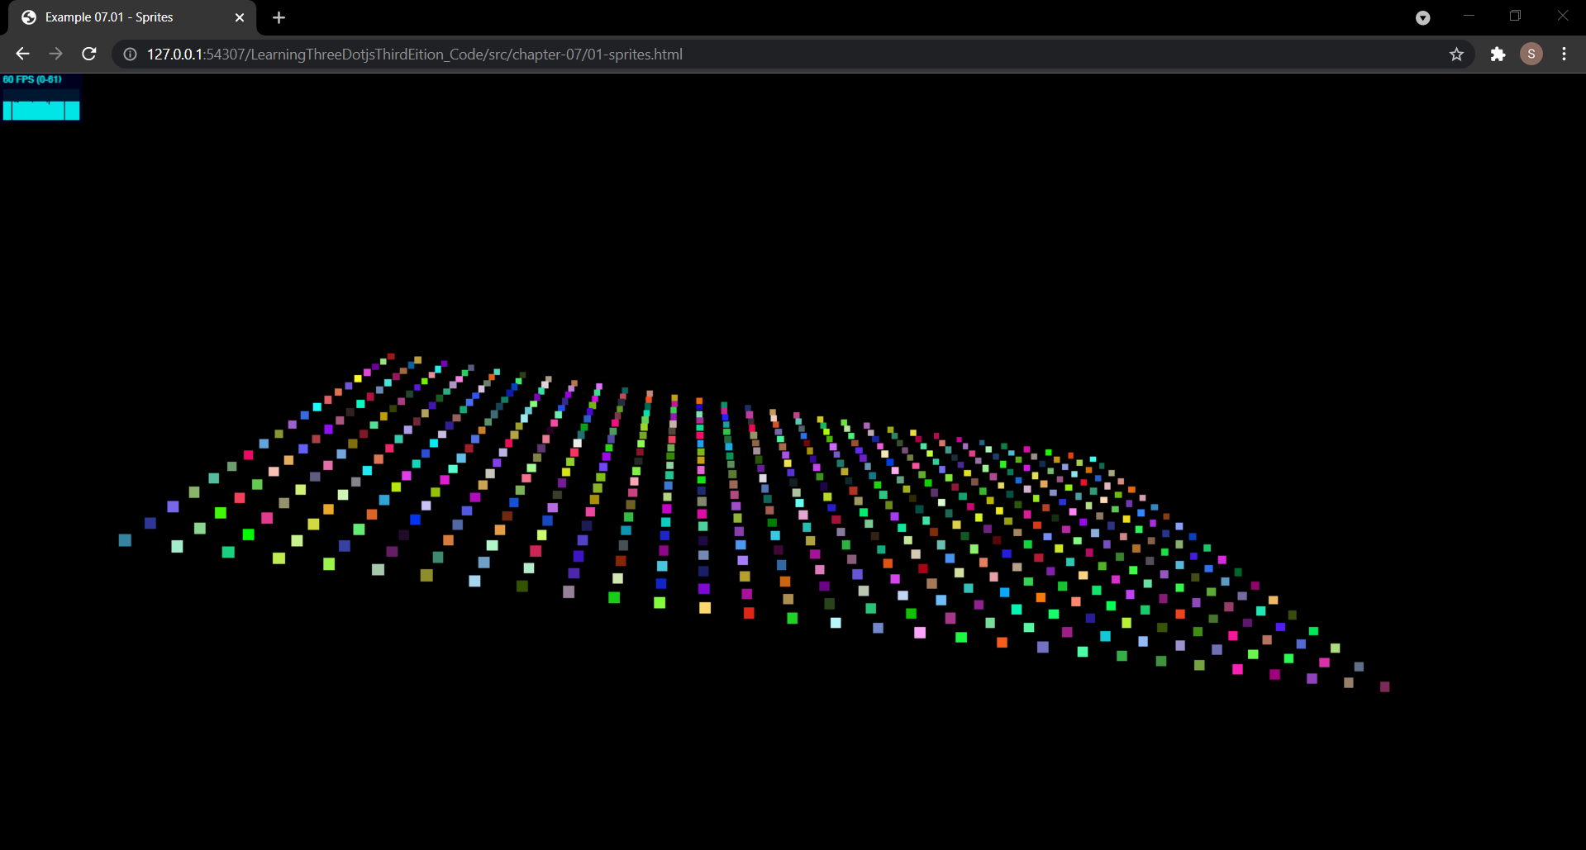
What you see in these screenshots is a result of the example function code before. Also these are a number of sprites.
A sprite is a 2D plane that always faces the camera. If you create a sprite without any properties, they are rendered as small, white, two-dimensional squares.
A THREE.Sprite object extends from the THREE.Object3D object just as THREE.Mesh does. This means that most of the properties and functions you know from THREE.Mesh can be used on THREE.Sprite. We can set its position using the position attribute, scale it using the scale property, and move it along its axes using the translate property.

Slide 32
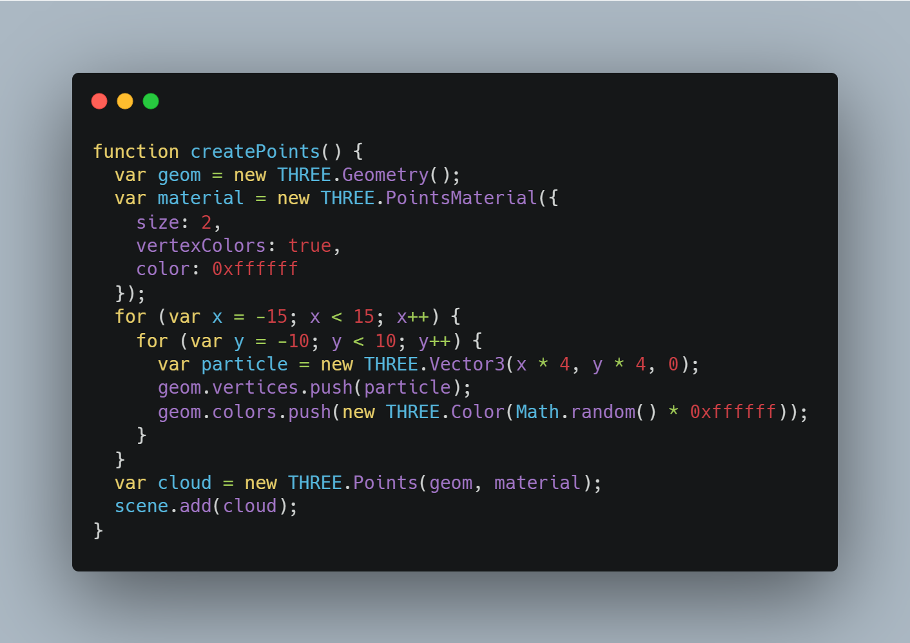
Points
To get the same result as the screenshot we saw earlier, but this time using THREE.Points, we do the following code.
As you can see, for each point, we need to create a vertex (represented by THREE.Vector3), add it to THREE.Geometry, use THREE.Geometry together with THREE.PointsMaterial to create THREE.Points, and add cloud to the scene. .

Slide 33
When do we use it?
03

Slide 34
With THREE.Sprite, we can very easily create a set of objects and move them around the scene. This works well when we're working with a small number of objects, but we'll quickly run into performance issues when we want to work with a high number of THREE.Sprite objects because each of the objects needs to be managed separately by Three.js.
Three.js provides an alternative way of handling a large number of sprites (or particles) using a THREE.Points object. With THREE.Points, Three.js doesn't have to manage many individual THREE.Sprite objects, just the THREE.Points instance.

Slide 35
Why is it important?
04

Slide 36
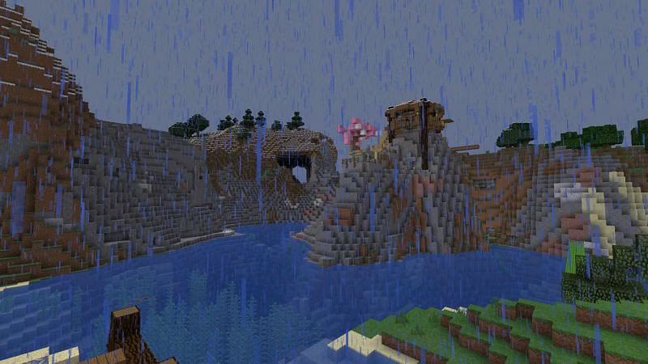
Because when the program needs to render particle, for example rain, the program doesn’t need to render spherical object to represent each raindrop, it just needs to render a lot of moving object that small enough to make the user think it is a rain drop, just like in Minecraft game. so it is based on performance.

Slide 37
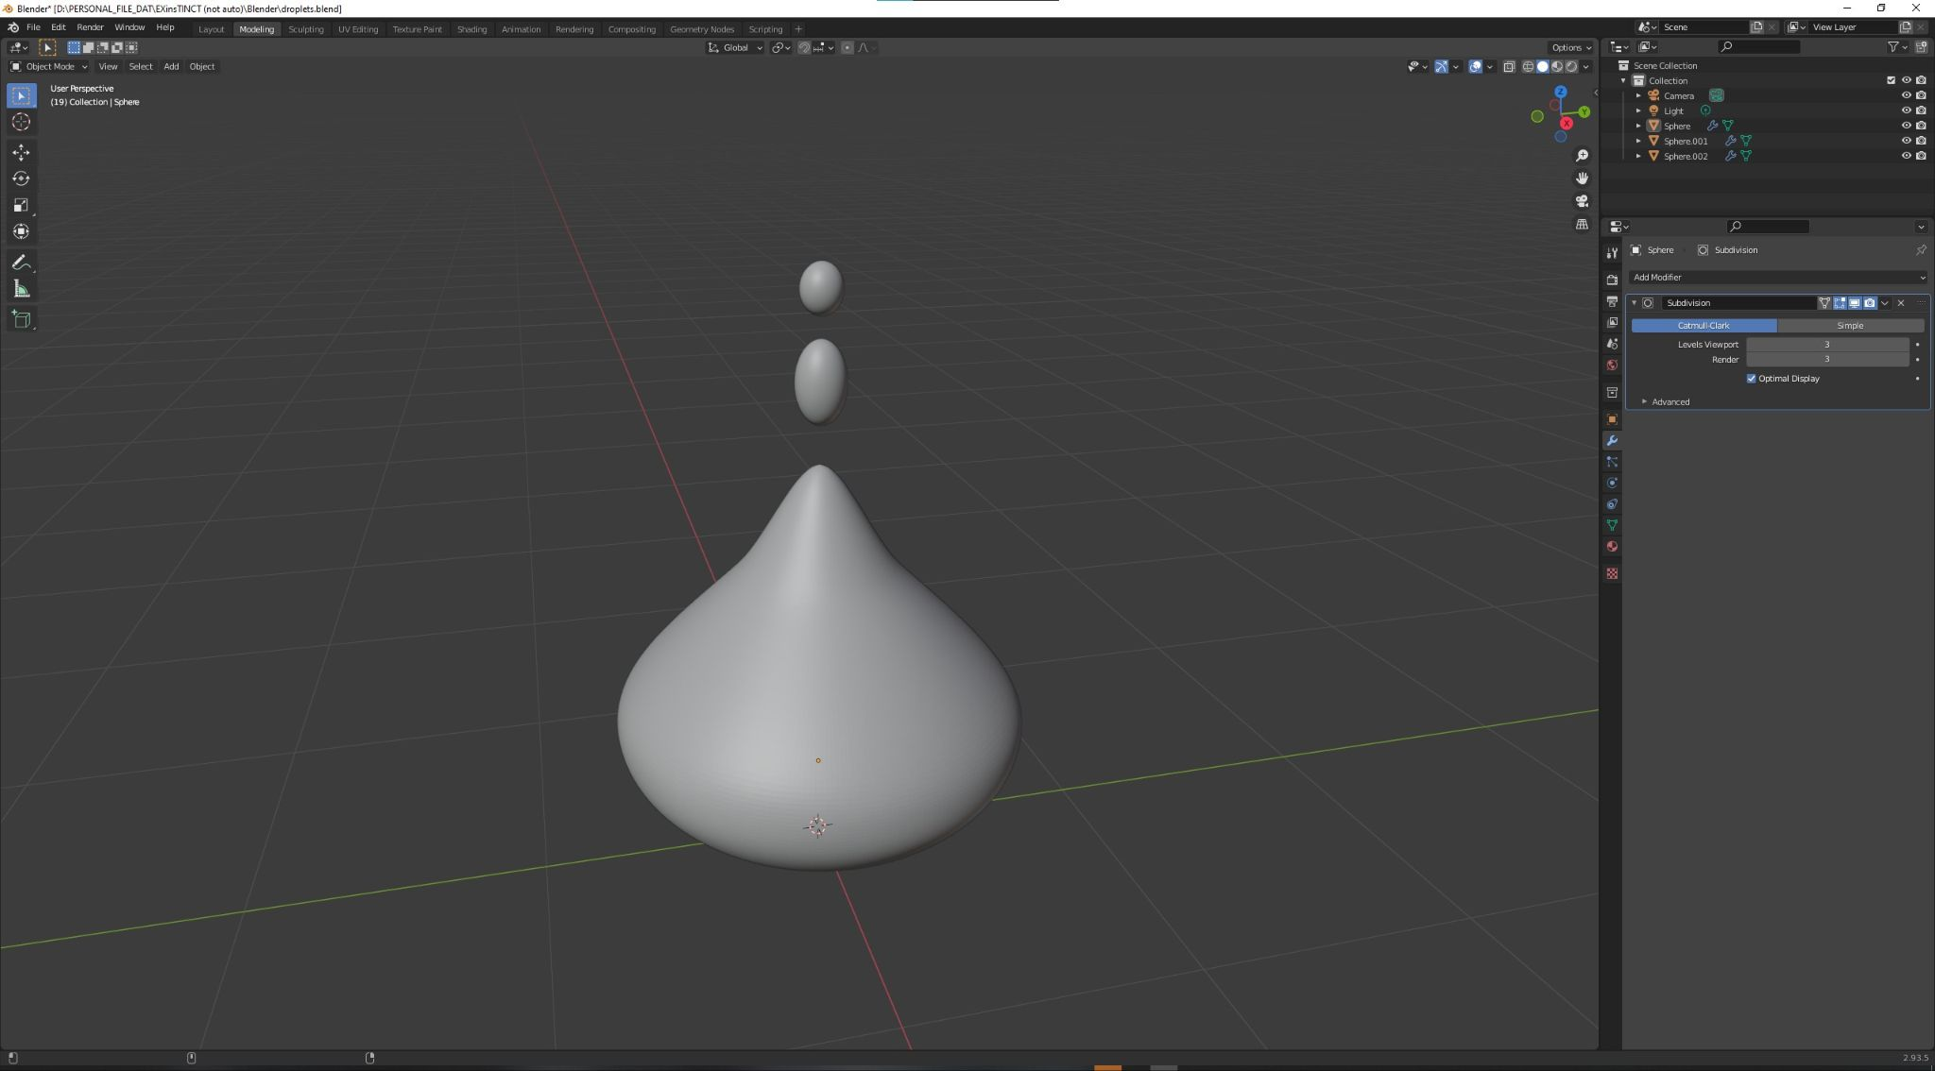
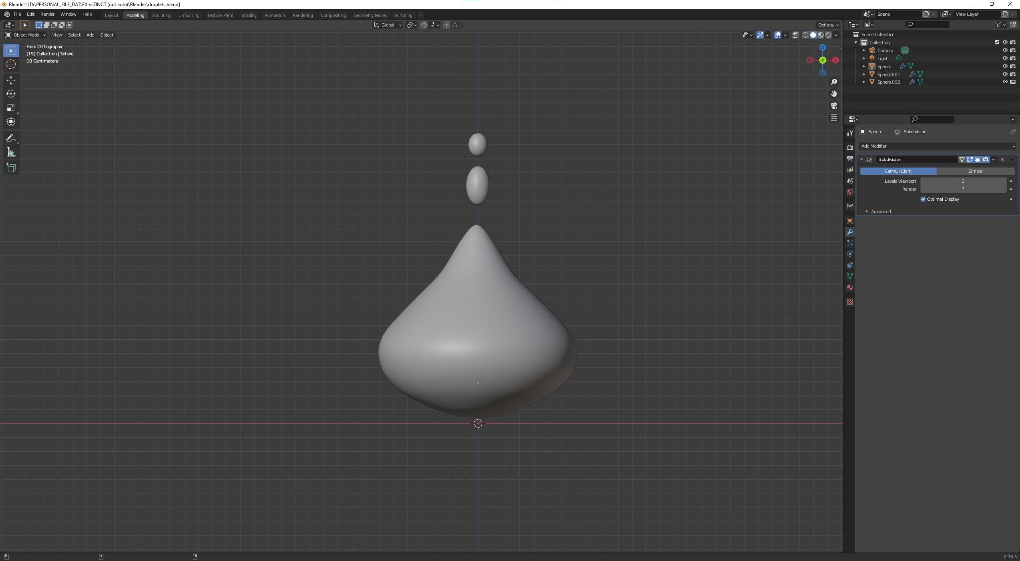
Imagine if every single raindrop is like this.

Slide 38
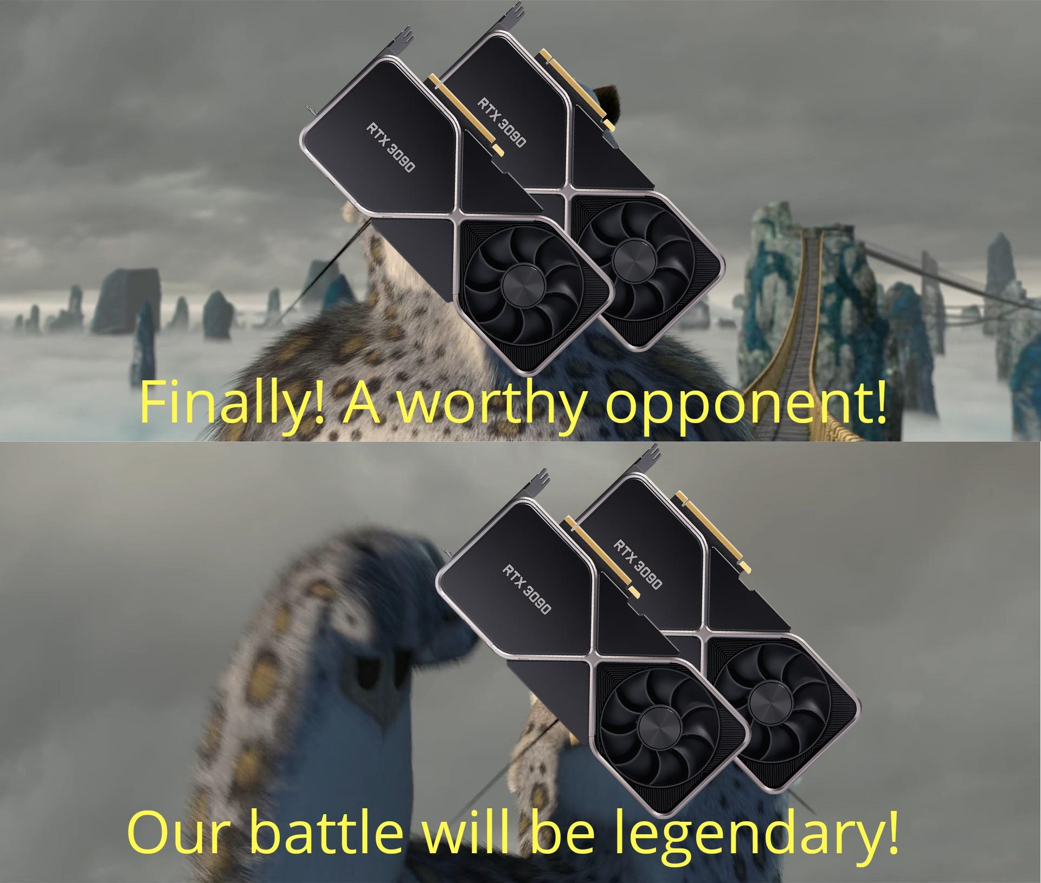

Slide 39
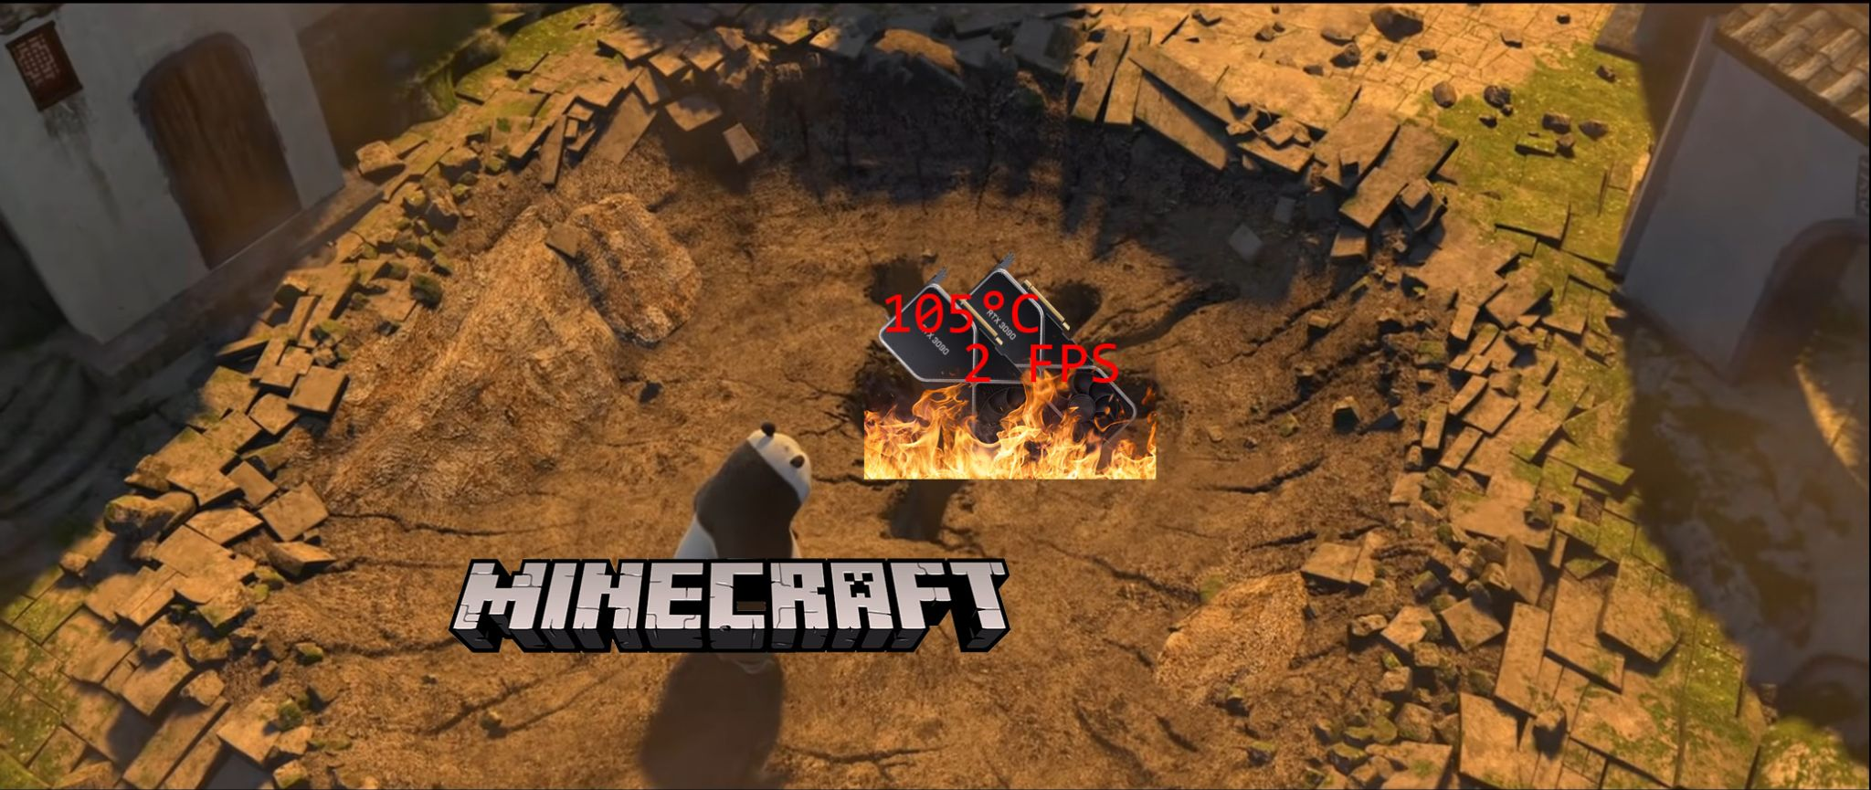

Slide 40
Codes Example
05

